Slide 1
Cell-associated HIV RNA and the ratio of HIV RNA to DNA have circadian cycles in HIV-positive individuals on antiretoviral therapy
Jared Stern, Michael Roche, Ajantha Solomon, Ashanti Dantanarayana, Arnold Reynaldi, Miles Davenport, Melissa Churchill, Steven G Deeks, Wendy Hartogensis, Frederick M Hecht, Leslie Cockerham, Sharon R Lewin
IAS Conference on HIV Science,
Mexico City 2019
We acknowledge the involvement of HIV+ individuals in this study and are grateful for their contributions
The Miller Foundation Scholarship for Infection and Immunity

Slide 2
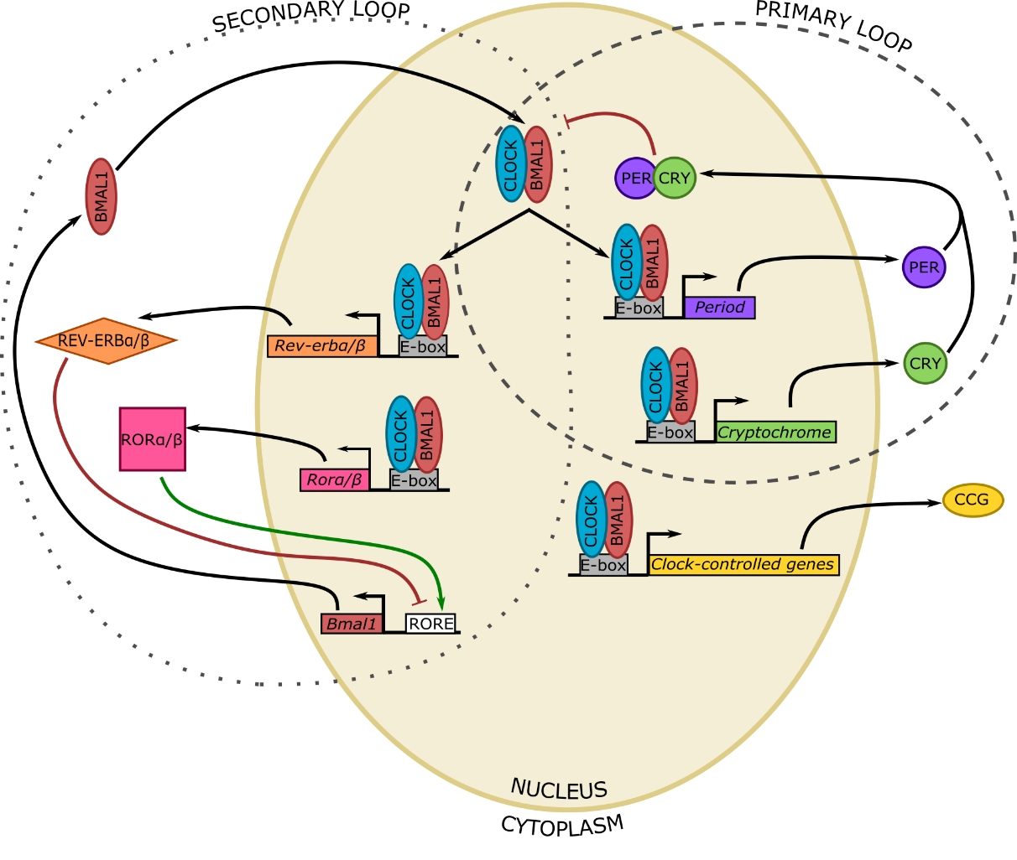
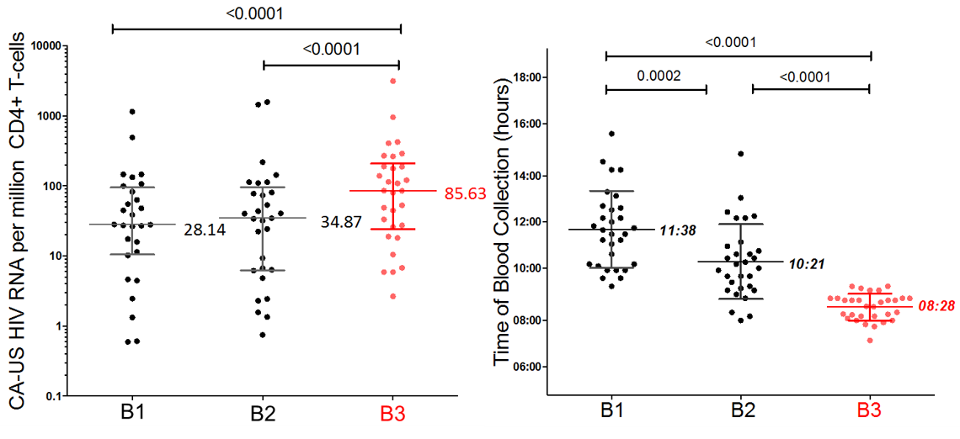
Cell-associated unspliced HIV RNA varies temporally in virally suppressed HIV+ individuals
N=30 participants in a randomised clinical trial. B1 = screening; B2 = between screening and enrolment; B3 = day of administration of disulfiram
CLOCK and BMAL1 heterodimers bind to an E-box to drive transcription
Control is mediated through Per and Cry genes
Gekakis et al., Science 1998; Hogenesch et al., PNAS 1998; Kume et al., Cell 1999; Jin et al., Cell 1999, Elliott et al., Lancet HIV 2015, Chang et al., AIDS 2018
Notes:
Although current antiretroviral therapy is highly effective in preventing viral replication and disease progression, it does not reduce the latent viral reservoir established early in infection. One approach to a cure is that of the shock and kill approach wherein latency reversing agents (LRAs) are administered to purge the latent reservoir so that these infected cells can be cleared. In a recent clinical trial examining the efficacy of disulfiram as an LRA performed in our laboratory, we observed that cell associated unspliced HIV RNA in CD4+ T-cells from blood was variable at different time points prior to the administration of the drug. More specifically, CA-US HIV RNA was measured on three occasions, once at screening (B1), once prior to administration of disulfiram (B3) and at a point in between (B2). At the timepoint immediately prior to the administration of disulfiram (B3), CA-US HIV RNA was 2.5 to 3-fold higher than the other timepoints. It was also found that these samples were collected significantly earlier during the day compared to the other timepoints. We therefore hypothesised that there was an association between basal levels of HIV transcription on ART and time, which would involve the circadian cycle.
Cell-autonomous circadian cycles consist of numerous interacting feedback loops. In the primary loop, clock and bmal1 heterodimerise to bind gene promoters and initiate transcription of clock-controlled genes. Two of the proteins whose expression is induced by CLOCK:BMAL1 are Cry and Per which also heterodimerise and then inhibit clock:bmal1 function. That is to say, they inhibit their own production and once the proteins degrade, CLOCK:BMAL1 are no longer inhibited and thus initiate the cycle again.

Slide 3
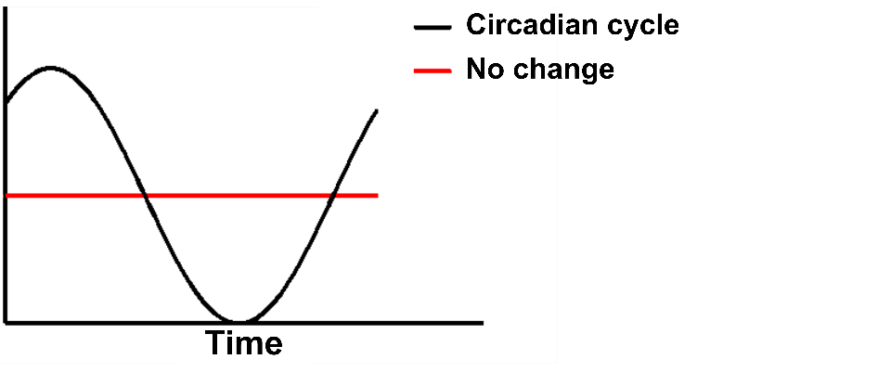
Evaluating changes in HIV transcription over the 24-hour day
Circadian HIV RNA Oscillations and Outcomes of Stress (CHRONOS) – a prospective study of HIV-positive individuals on ART (n=17). Inpatient admission at the University of Wisconsin
Notes:
To better understand the temporal variations that exist in HIV transcription naturally, we ran a prospective study of 17 HIV-positive participants under observation for 24 hours. Blood and salivary samples were taken every four hours and levels of stress and sex hormones known to vary diurnally were measured. CD4+ T-cells were isolated from PBMCs and cell-associated HIV DNA, CA-US HIV RNA were measured, as well as mRNA of several circadian genes (Clock, Bmal1, Period1-3, Cryptochrome1-2) measured by qPCR using a relative standard curve method

Slide 4
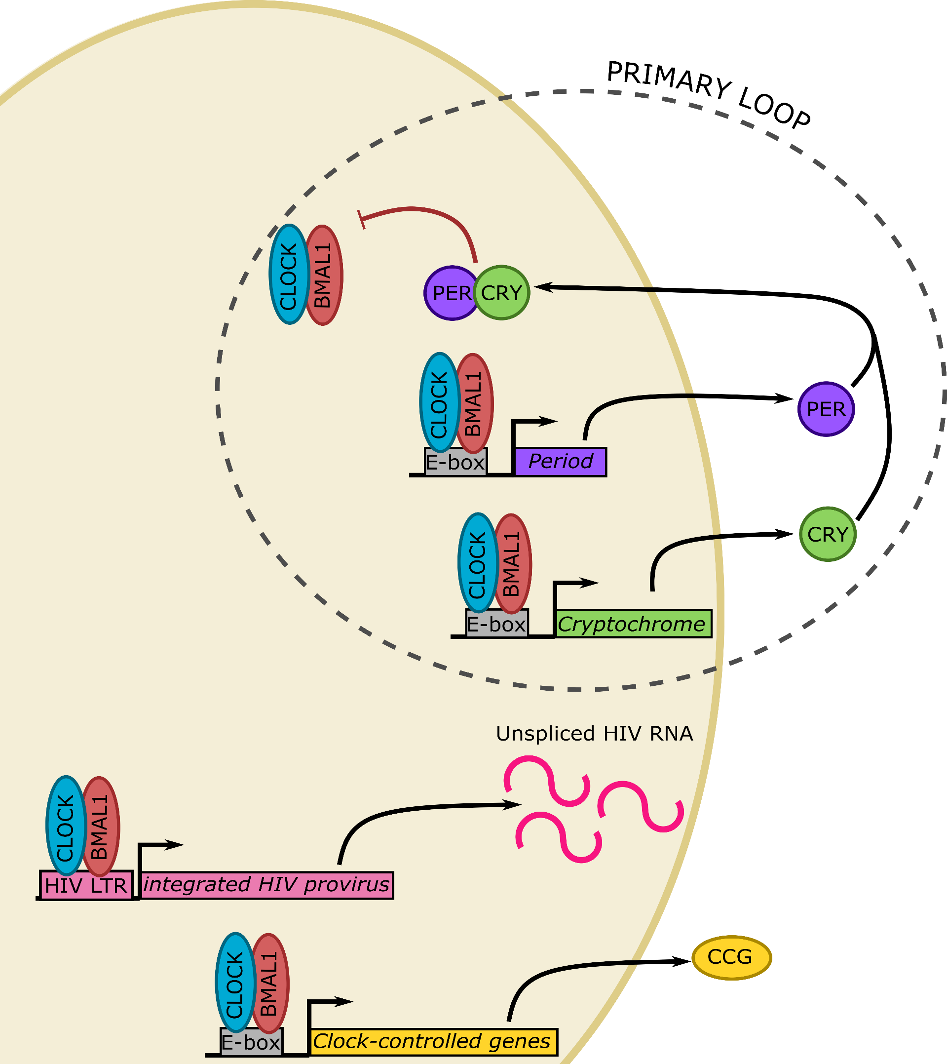
Circadian genes, hormones, and CA-US HIV RNA – but not HIV DNA – cycle over a 24-hour period
p<0.0001
p=0.0181
p=0.0368
p=0.0485
p=0.18
p=0.0007
n=17, black dots represent each individual, blue line represents the mean of the cohort at each timepoint, and the pink line represents the circadian cycle model fitted to the experimental data
Notes:
From these analyses, we found that almost all of the tested parameters displayed circadian cycles. All seven circadian genes showed cycling, with Clock and Per3 peaking during midday and the early morning, respectively, whilst the other circadian genes peaked around midnight. Cortisol levels, both salivary and in the plasma, peaked in the early morning, pre-emptive of the active phase during the day. Interestingly, cell-associated unspliced HIV RNA and the HIV RNA:DNA ratio also showed circadian cycling, peaking at midnight and late night respectively, although HIV DNA remained constant over the observation period.
These data show that HIV-positive individuals on suppressive ART have intact circadian cycles at a systemic level – indicated by their cortisol cycling – as well as within their CD4+ T-cells, indicated by the circadian gene cycling. Furthermore, HIV transcription cycles in a circadian manner in these individuals, and this isn’t explained by cell trafficking as we didn’t see any temporal changes in HIV DNA. We therefore posit that in latently infected cells, the circadian cycle, by means of direct interaction of CLOCK and BMAL1 with the HIV LTR, control basal levels of HIV transcription. As such, the circadian cycle offers a novel pathway to be exploited as part of the shock and kill approach to achieve a cure.

Slide 6
Acknowledgements
The Peter Doherty Institute for Infection and Immunity
Lewin/Cameron Laboratory
Sharon Lewin
Paul Cameron
Jenny Anderson
Ajantha Rhodes
Ashanti Dantanarayana
Wei Zhao
Jenn Zerbato
Youry Kim
Talia Mota
Judy Chang
Harrison Purves
Purcell Laboratory
Damian Purcell
UCSF
Steven Deeks
Wendy Hartogensis
Rick Hecht
Medical College of Wisconsin
Leslie Cockerham
RMIT University
Melissa Churchill
Michael Roche
Carolin Tumpach
Jingling Zhou
The Kirby Institute
Miles Davenport
Arnold Reynaldi
The Miller Foundation Scholarship for Infection and Immunity
We acknowledge the involvement of HIV+ individuals in this study and are grateful for their contributions

Slide 7
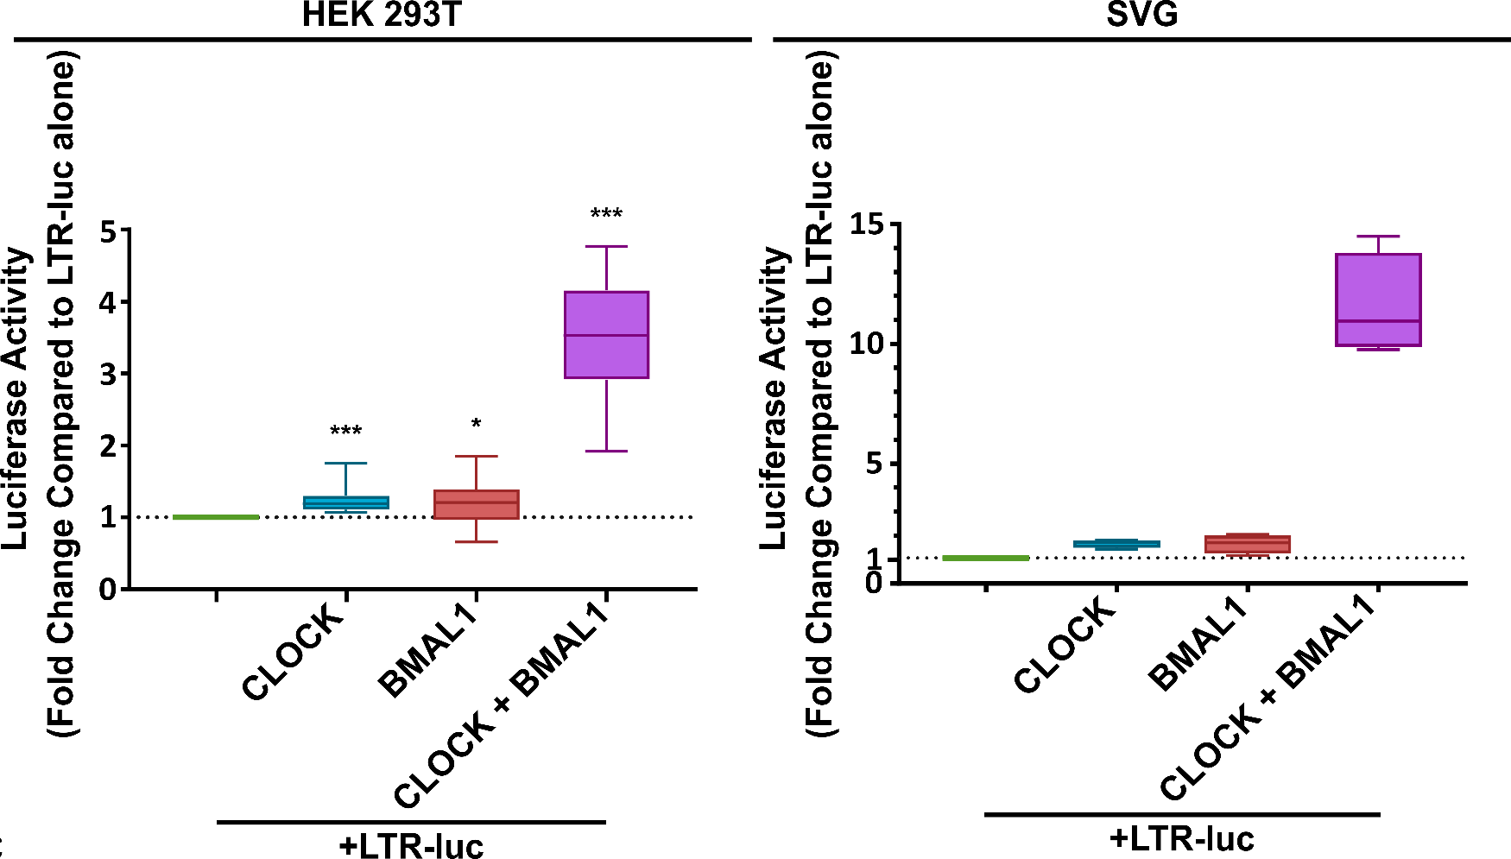
CLOCK/BMAL1 Together Increase LTR Activity
CLOCK and BMAL1 alone had little effect on LTR-driven transcription
CLOCK and BMAL1 together resulted in a 3.32- and 10.22-fold increase in LTR-mediated transcription in HEK 293T and SVG cell lines, respectively
Chang et al. AIDS 2018 n=13, IQR and range
*P < 0.05, **P < 0.01, ***P < 0.001
Courtesy of Jingling
n=4, IQR and range
Notes:
Well, given the presence of E-box motifs in the LTR, we hypothesised that the observed relationship between time, BMAL1, and cell-associated unspliced HIV RNA was due to direct interaction of BMAL1 with the LTR to affect HIV transcription. In a transfection system using a luciferase reporter driven by the HIV LTR, transfecting in CLOCK:BMAL1 together induced a 3.32- and 10.22-fold increase in HIV transcription in HEK 293T cells and SVG cells, respectively Whilst CLOCK or BMAL1 alone also significantly increased HIV transcription, this effect was much more modest at only 1-2 fold above baseline.

Slide 8
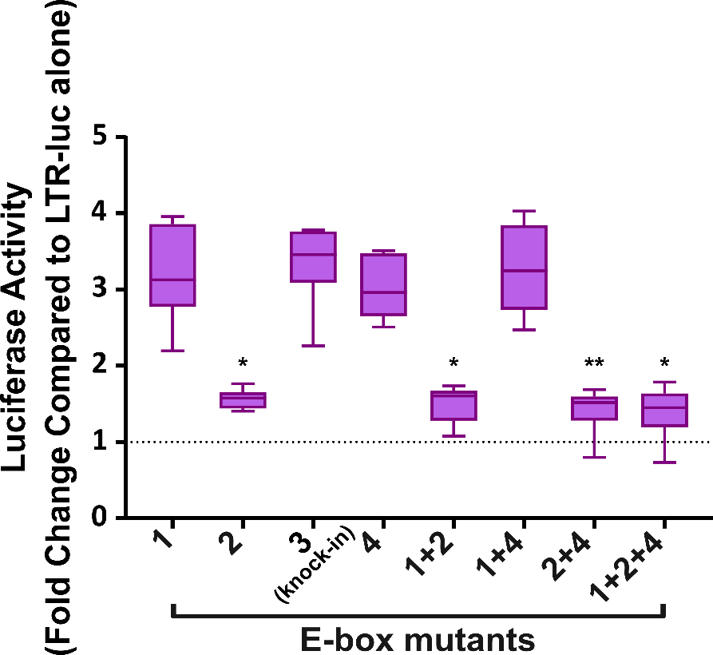
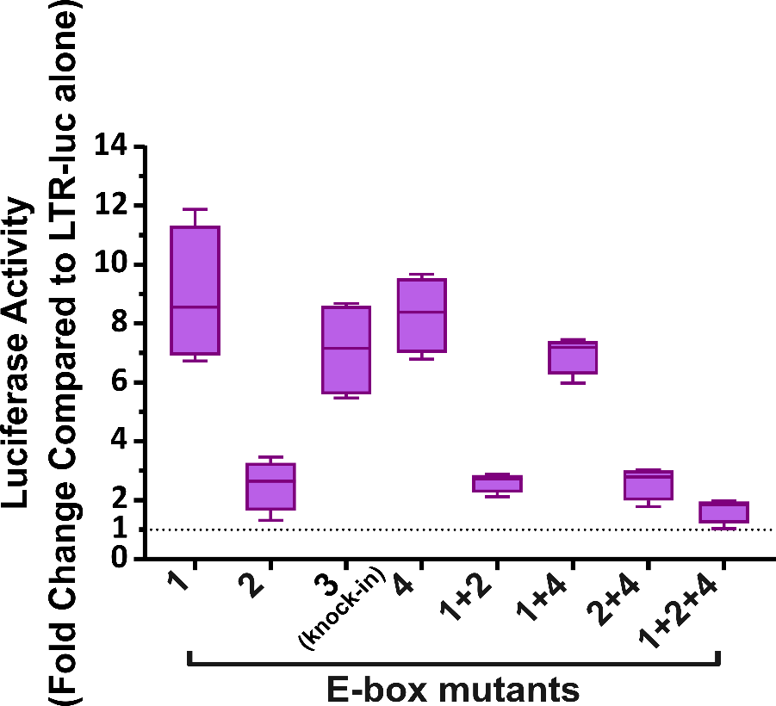
E-box 2 is Necessary for CLOCK/BMAL1-mediated HIV Transcription
Adapted from Chang et al. AIDS 2018 n=6, IQR and range
*P < 0.05, **P < 0.01, ***P < 0.001
Courtesy of Jingling n=4, IQR and range
Notes:
Furthermore, using site-directed mutagenesis of each of the four putative E-boxes in the HIV LTR, individually or in concert, revealed that knocking out E-box 2 almost completely abolished CLOCK:BMAL1’s upregulation of HIV transcription, reducing HIV transcription by 69% and 83% in 293T and SVG cells respectively. Further mutation of other E-boxes on top of E-box motif 2 didn’t enhance the abolishment, indicating that it’s solely E-box 2 that is required for CLOCK:BMAL1’s mediation of HIV transcription.

Slide 9
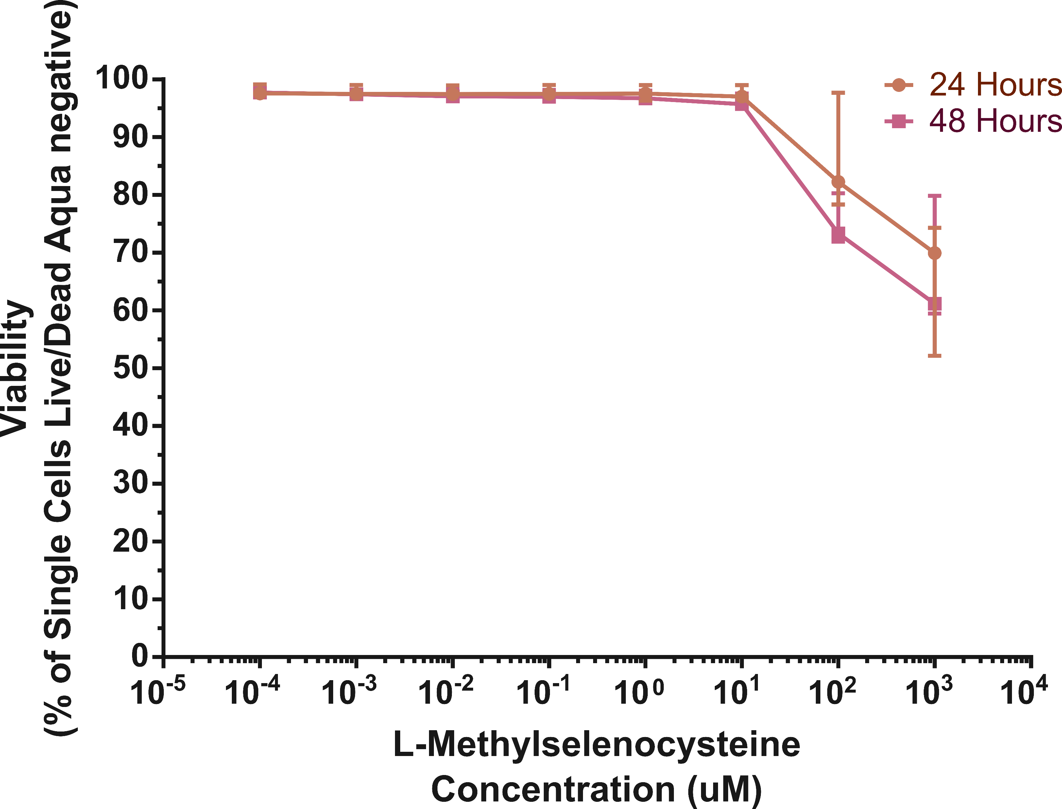
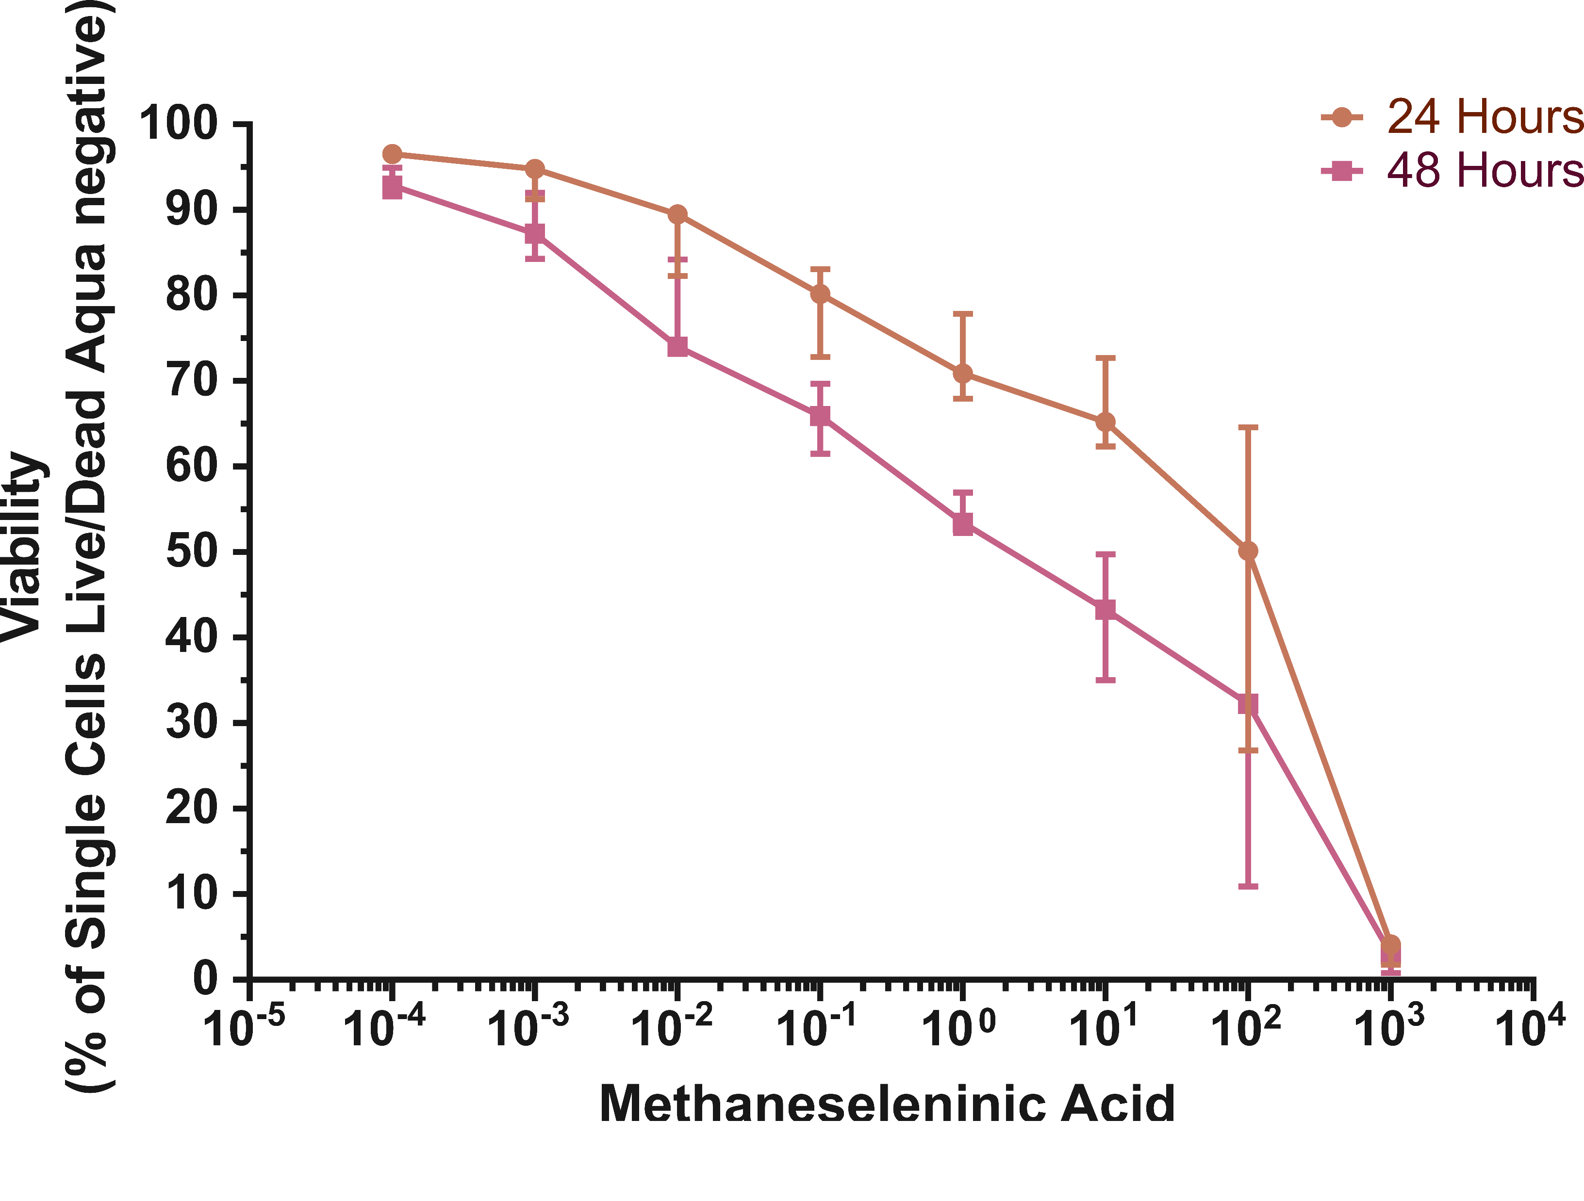
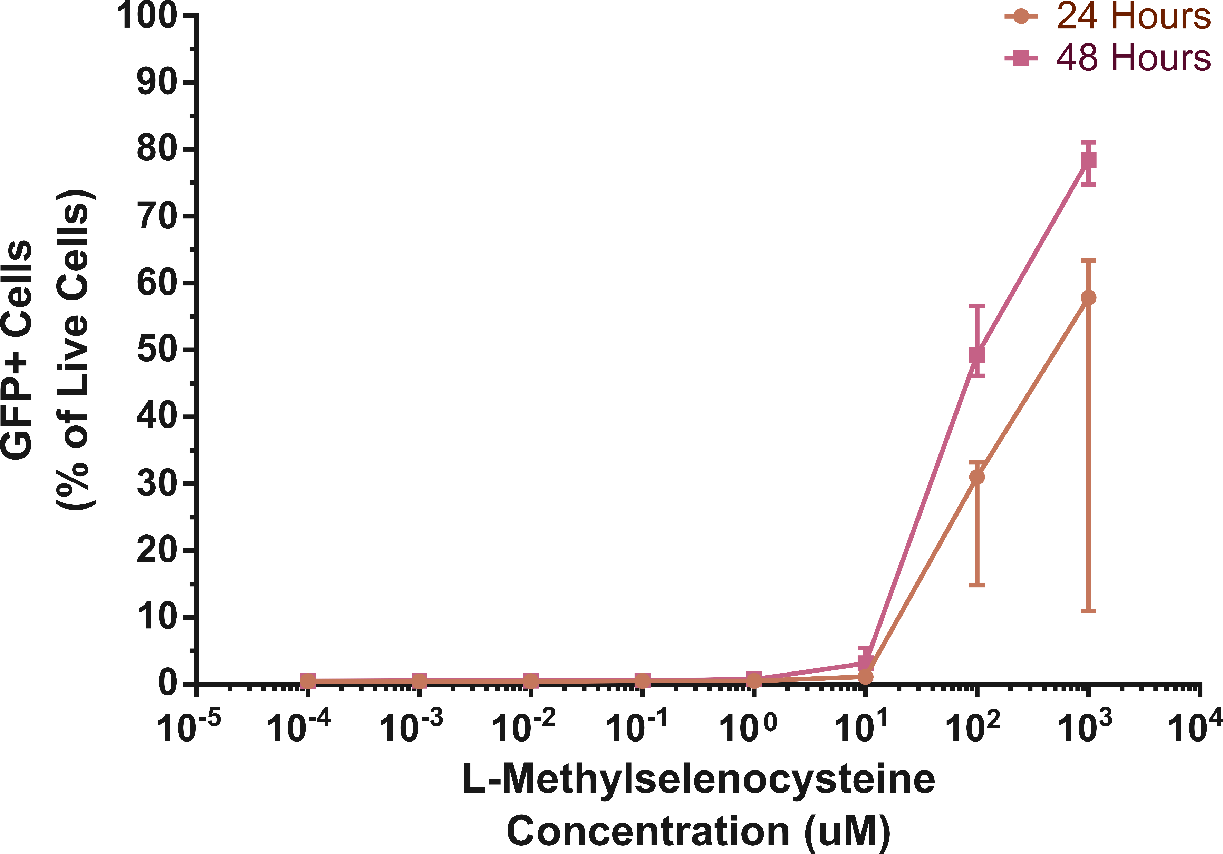
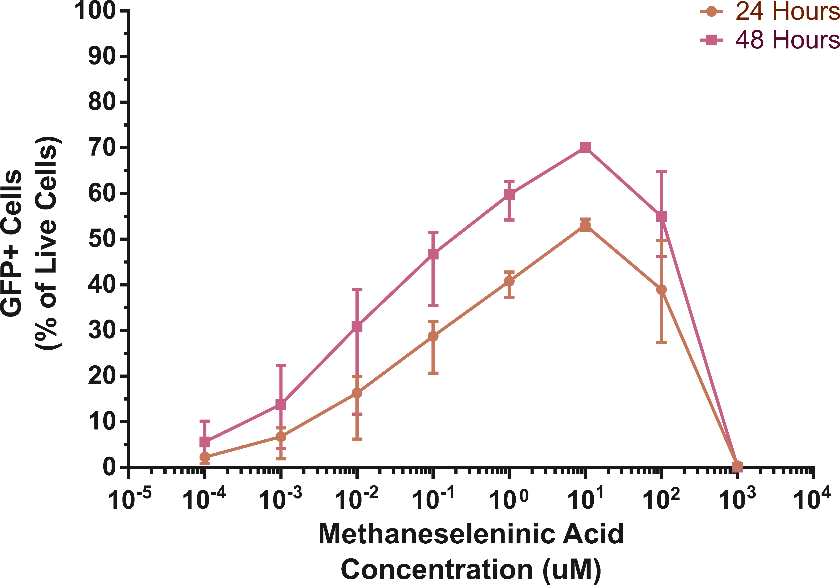
Selenium compounds potently reactivate HIV, but not without toxicity
n=3, median and range
Notes:
Conversely, both of the selenium compounds, methylselenocysteine and methaneseleninic acid were highly potent in reactivating HIV. Methylselenocysteine, or MSC, was very potent at high concentrations, resulting in a maximum of 78.5% GFP expression. Conversely, Methaneseleninic acid or MSA was much more potent at lower concentrations, with even the lowest concentration resulting in reactivation and a maximum of 70% reactivation being achieved using this drug. Though, both of these drugs, particularly MSA, had quite high toxicities.

Slide 10
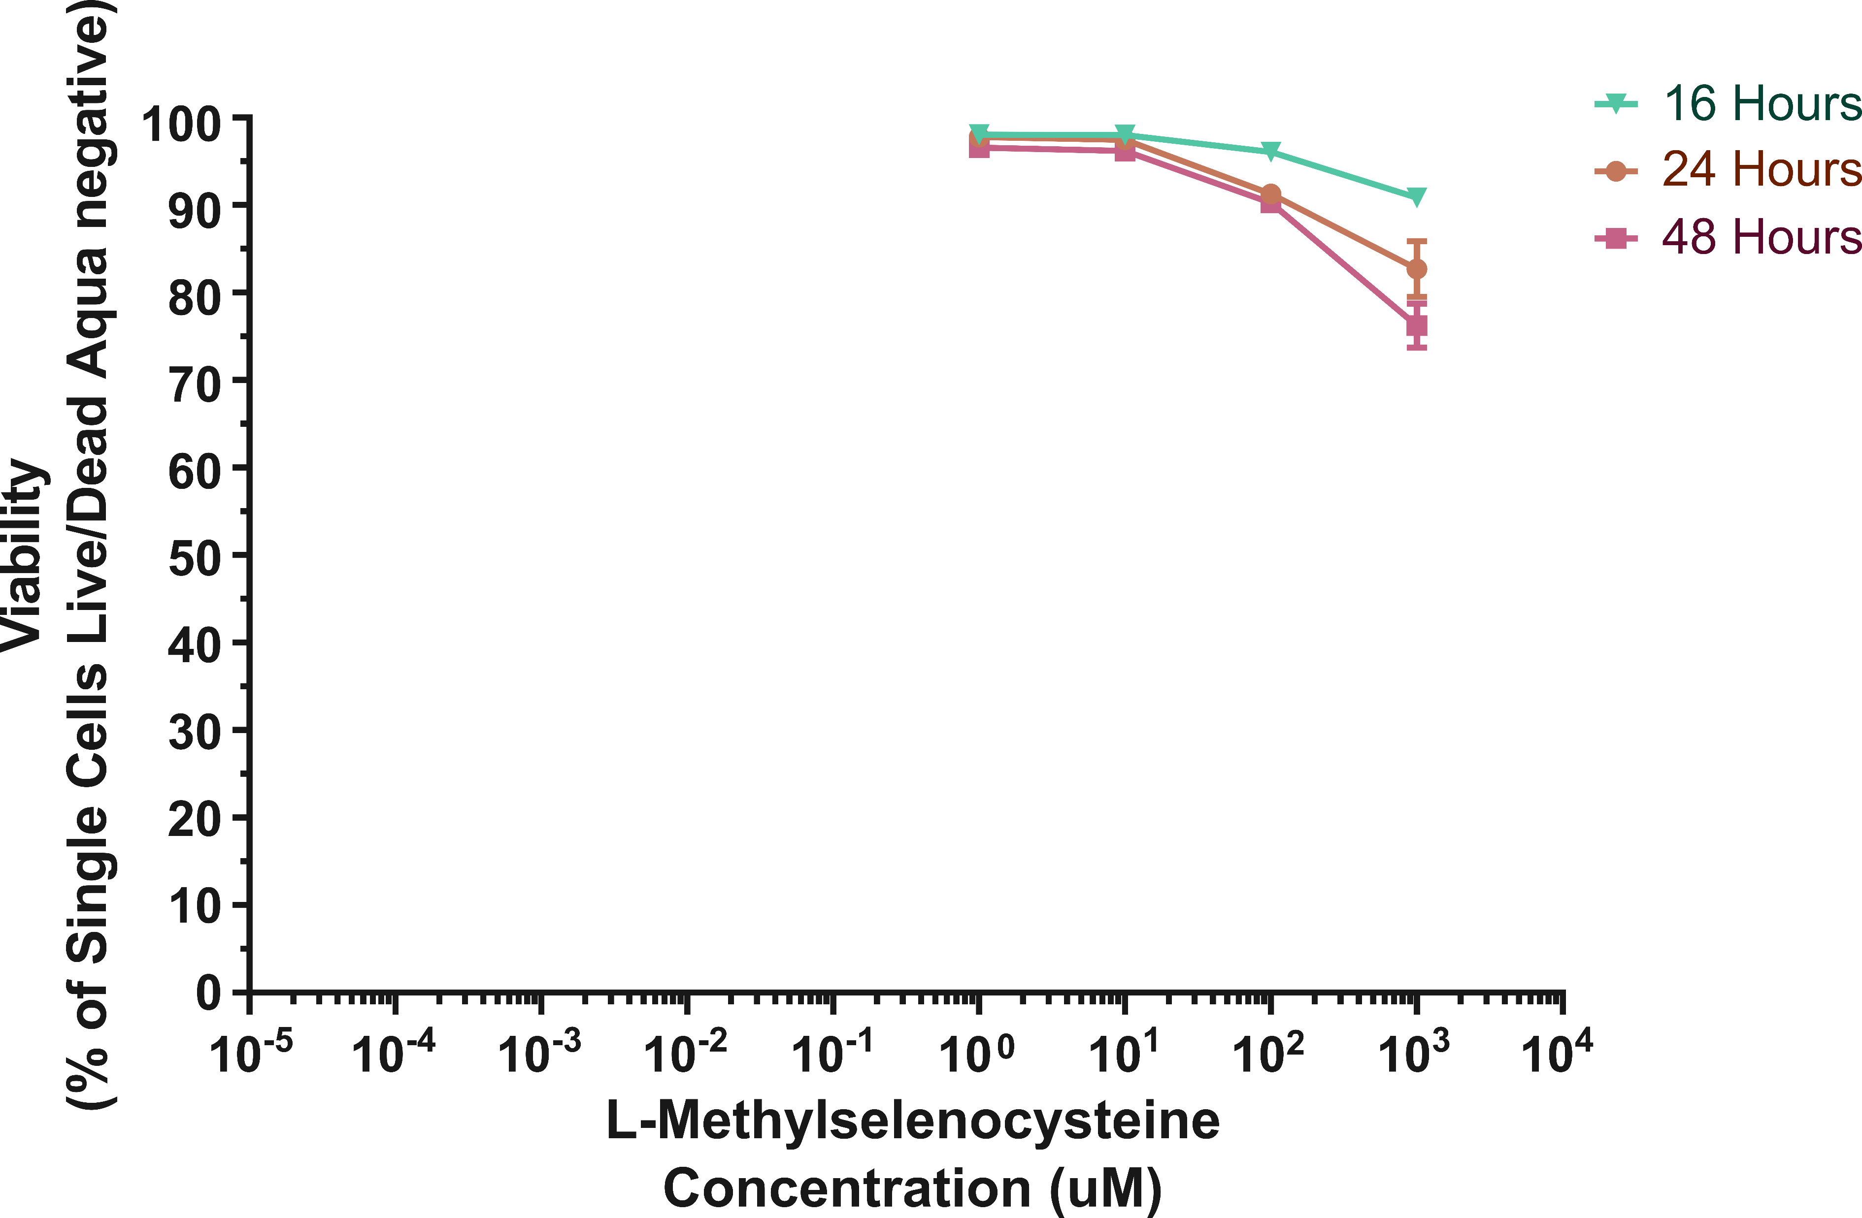
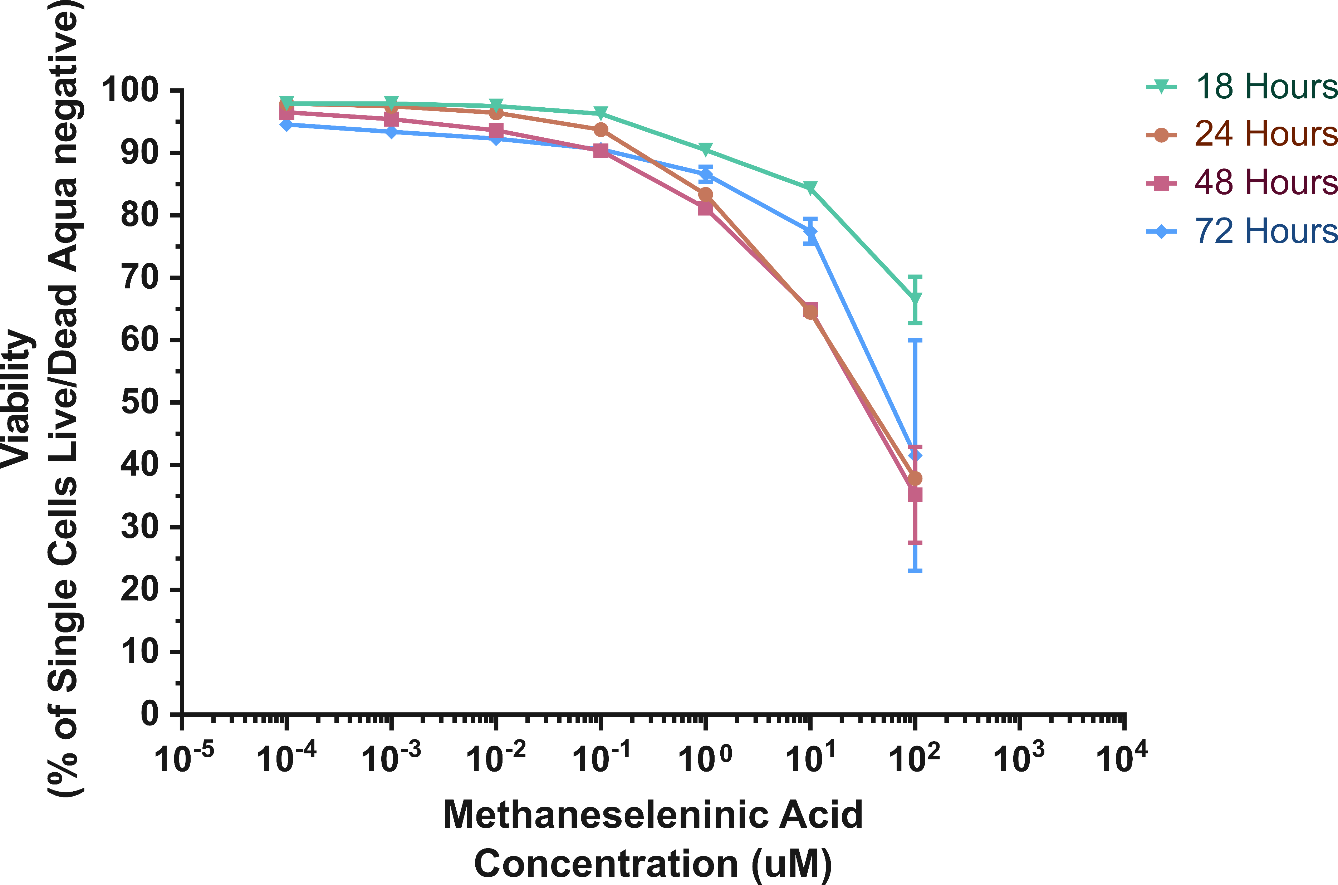
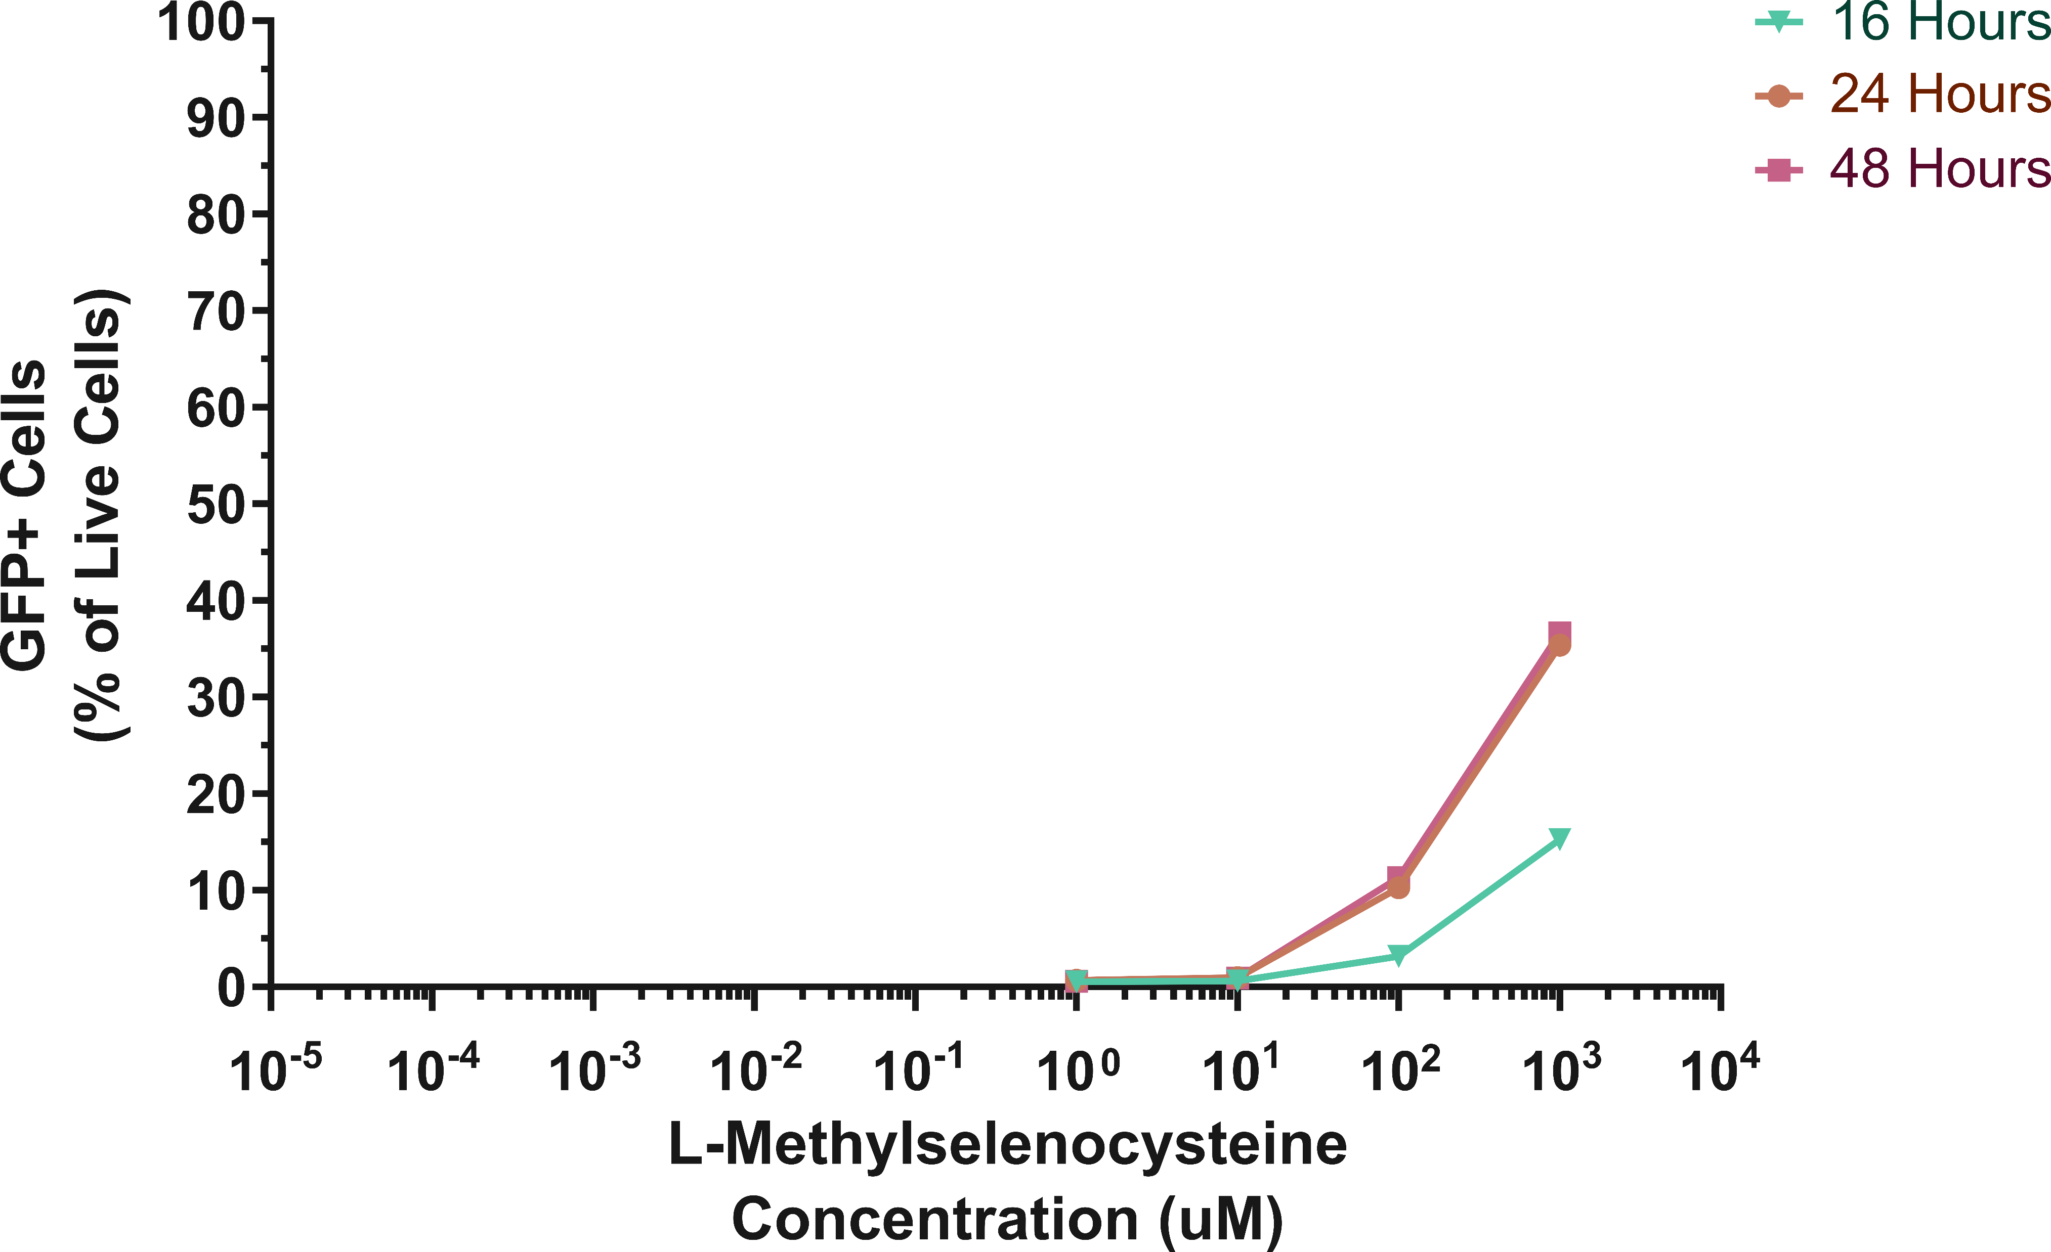
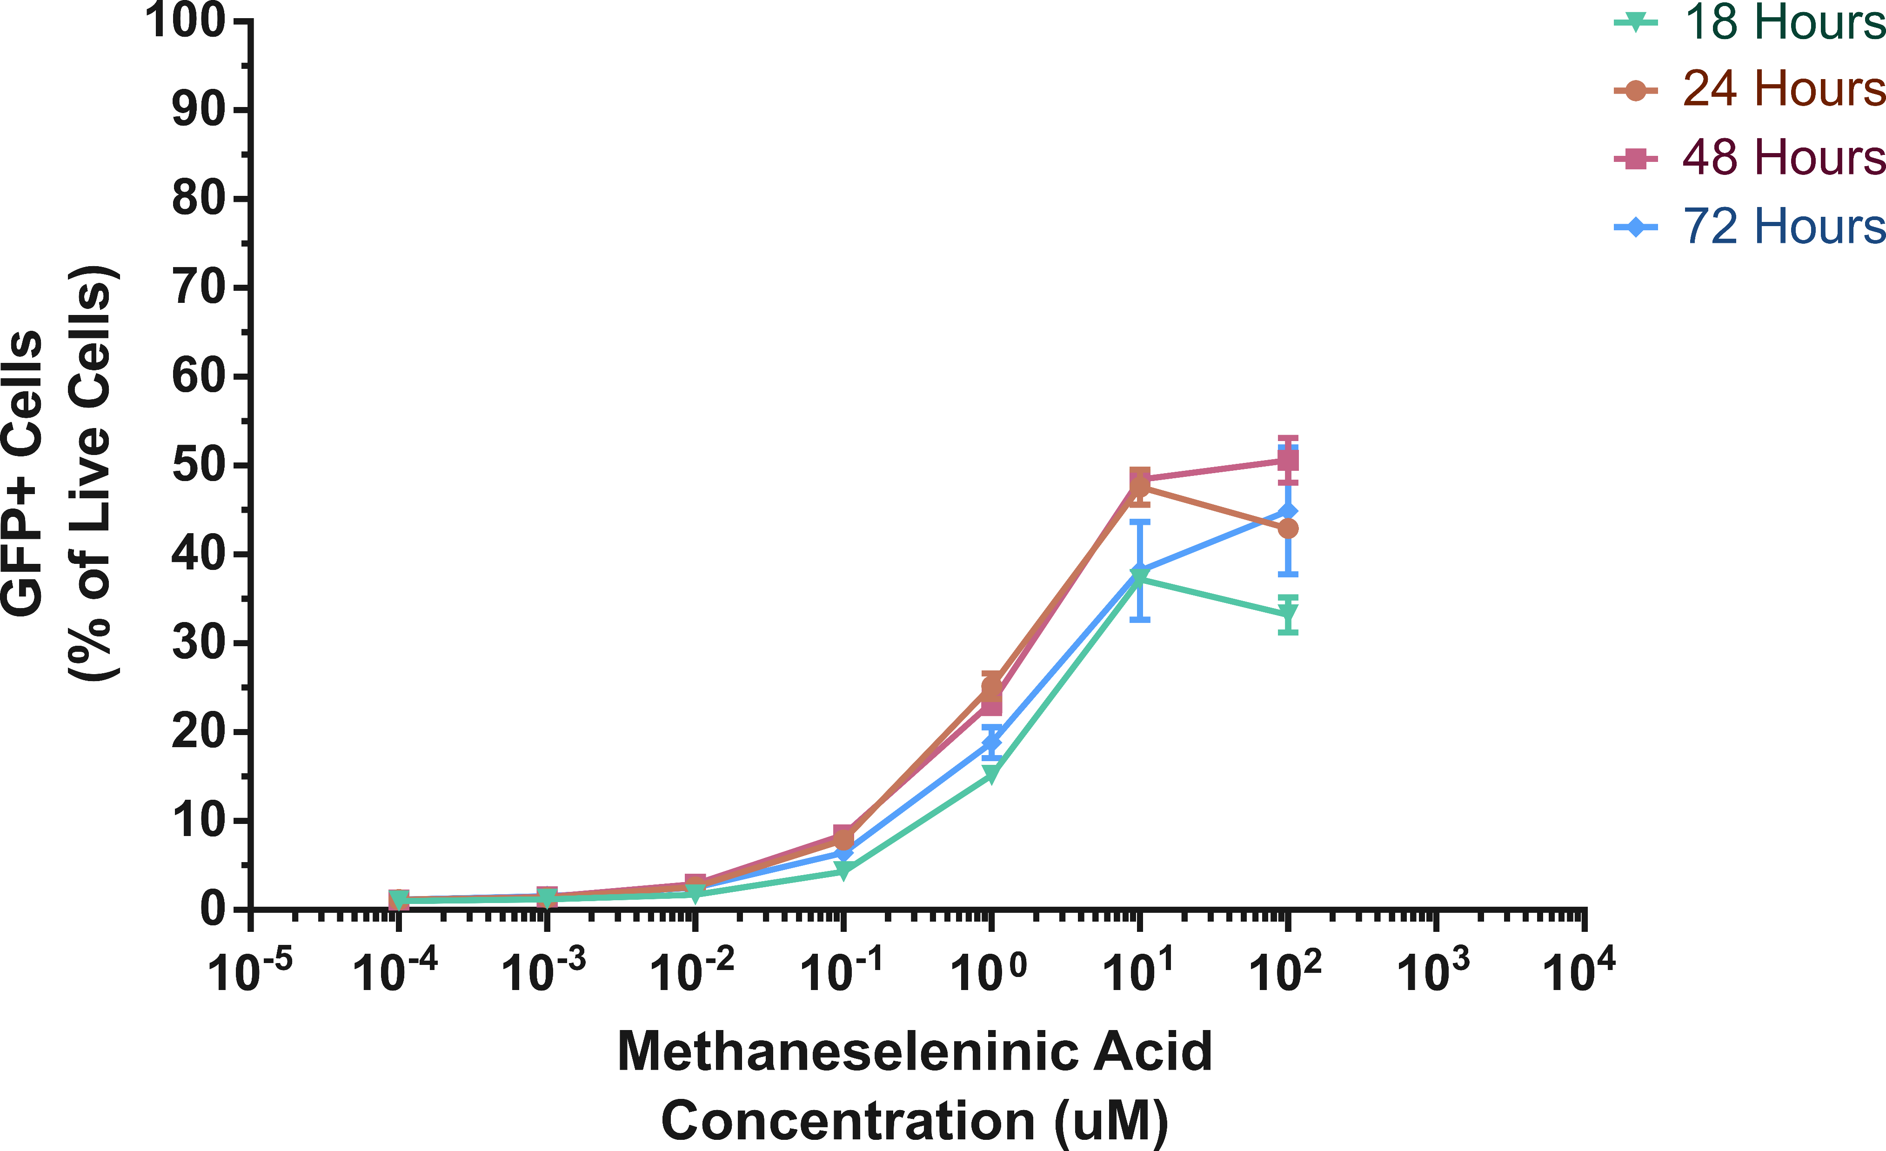
Reducing the duration of stimulation improves toxicities whilst maintaining reactivation
n=1, mean, and upper and lower limits of triplicates
Notes:
Because of the high toxicity seen, we tried decreasing the stim time to 16-18 hours and this gave us a good balance between toxicity and reactivation. For MSC on the left, viability remained high and a maximal reactivation of 37% was achieved with 1mM drug.
For MSA, toxicity was still higher than MSC but it was greatly improved, and a high level of reactivation was still achieved maximum of 48.4% reactivation compared to the 70% achieved with a 24 hour From our MSA stimulation, we also followed the cells for a total of 72 hours, i.e. over 2 days after the drug has been washed off. From this, we found that cell viability began to recover between 48 and 72 hours and GFP expression was still maintained all the way through to 72 hours. So it does appear that the cells that were activated but survived were able to remain activated for a prolonged amount of time once the stimulus was removed. Though, this could also be because of the relatively long stability of GFP.

Slide 11
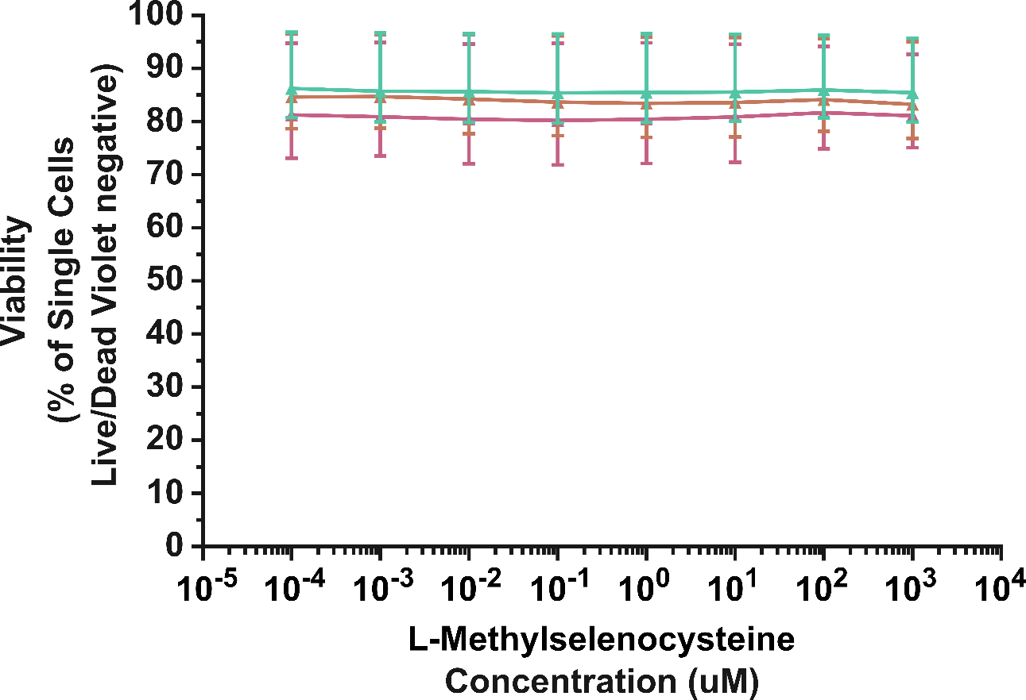
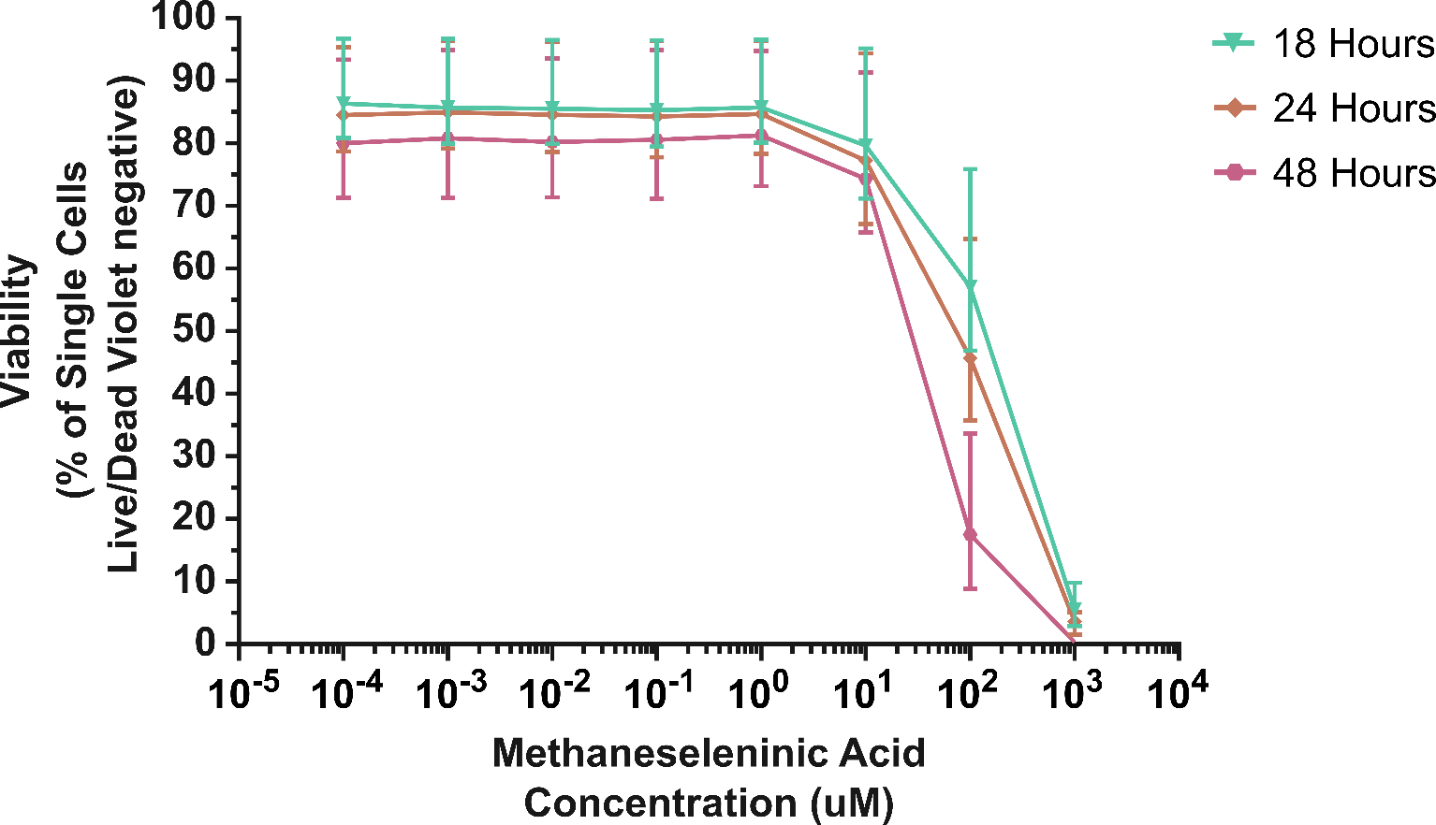
Selenium compounds are largely non-toxic in primary uninfected CD4+ T-cells
n=3 indep. donors, median and range
Notes:
As we ultimately want to test these compounds in cells from HIV-positive individuals, we isolated total CD4+ T-cells from three healthy donors and stimulated them for 18 hours with either of the two selenium compounds and measured their toxicities. Interestingly, in these cells, both compounds are far less toxic than when used in cell lines in vitro, with MSC on the left being completely non-toxic at all concentrations tested, and MSA only being toxic at the higher end of the spectrum. This observation that cell lines are more sensitive to the effects of these compounds could be reflective of the fact that the cell lines are cancerous cells and these compounds have been obtained from the cancer therapeutics-pipeline.

Slide 12
Summary
HIV-positive individuals on ART have intact circadian cycles
CA-US HIV RNA and the HIV RNA:DNA ratio, but not HIV DNA, cycle in a circadian manner
Accounting for changes in Bmal1 transcription helps better model changes in HIV transcription
CLOCK:BMAL1 can upregulate HIV transcription in vitro
Compounds known to increase Bmal1 transcription and translation can reactivate HIV in an in vitro cell line model
Cell-autonomous circadian cycles could be exploited as a target for the shock and kill approach to a cure
Notes:
X`In conclusion, from the prospective clinical trial, we found that HIV-positive individuals on suppressive ART have intact circadian cycles at a systemic level – indicated by their cortisol cycling – as well as within their CD4+ T-cells, indicated by the circadian gene cycling. Furthermore, HIV transcription cycles in a circadian manner in these individuals, and this isn’t explained by cell trafficking as we didn’t see any temporal changes in HIV DNA. Furthermore, accounting for the changes in Bmal1 transcription better predict the changes seen in HIV transcription.
In vitro we have shown that the major transcription factors, CLOCK and BMAL1, can upregulate HIV transcription and this effect is almost entirely dependent on a single E-box motif within the LTR promoter.
Finally, we have identified several circadian altering compounds that can reactivate latent HIV in vitro, particularly the selenium compounds which increase bmal1 transcription and translation.
Therefore cell-autonomous circadian cycles present a novel mechanism to be targeted as part of the shock and kill approach to a cure

